Slide 1

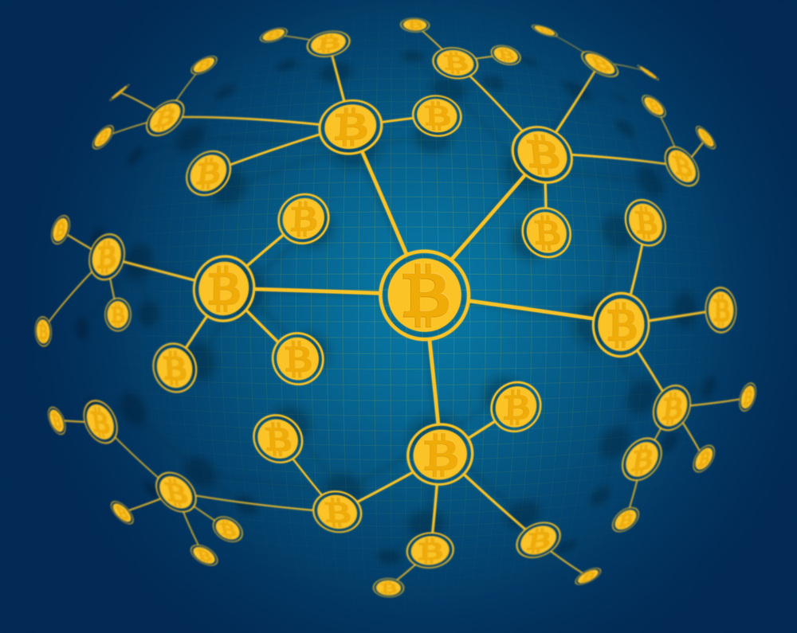

Introduction to
blockchain
Ramya M

Slide 2
CONTENTS
CONTENTS
What is Blockchain
How does a Blockchain work?
Key Features of Blockchain
Bitcoin
Ethereum
Consensus Algorithms
Merkle Tree
Applications of Blockchain

Slide 3
What is Blockchain?
Decentralized network
Shared database
Digitally distributed
Immutable public ledger
Stores data in growing list of ordered blocks that are linked together via cryptography
Structure that stores the transactional records across a peer-to-peer network in the blocks

Slide 4
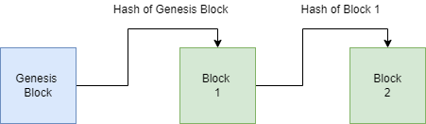
How does a Blockchain Work?

Slide 5
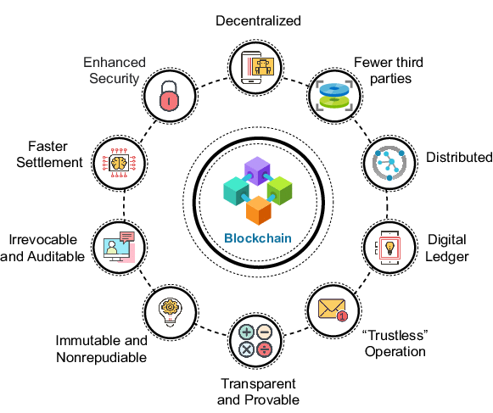
Key Features of Blockchain
Image Source: Hazra, Abhishek & Alkhayyat, Ahmed & Adhikari, Mainak. (2022). Blockchain-aided Integrated Edge Framework of Cybersecurity for Internet of Things. IEEE Consumer Electronics Magazine. PP. 1-1. 10.1109/MCE.2022.3141068

Slide 6

Bitcoin
Digital currency
Build on blockchain technology
Created by Satoshi Nakamoto in 2008
Supports features like:
Open hours
Low transactional fees
High transactional speed
KYC rules
Security
Privacy
Ease of transfers
Approved transactions

Slide 7
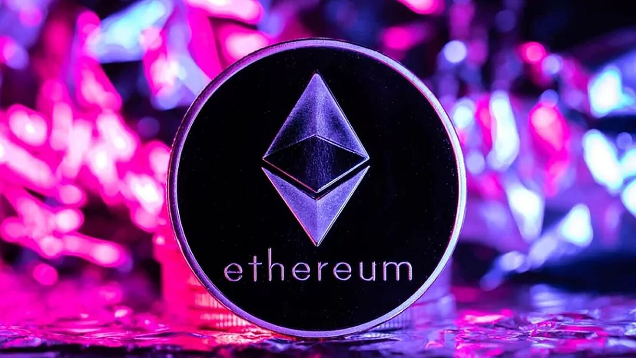
Ethereum
Digital currency
Launched in 2015
Unlike Bitcoin, it is programmable
Supports features like:
Security
Privacy
Peer-to-Peer transactions
Censorship resistant
Commerce guarantees
Composable products

Slide 8
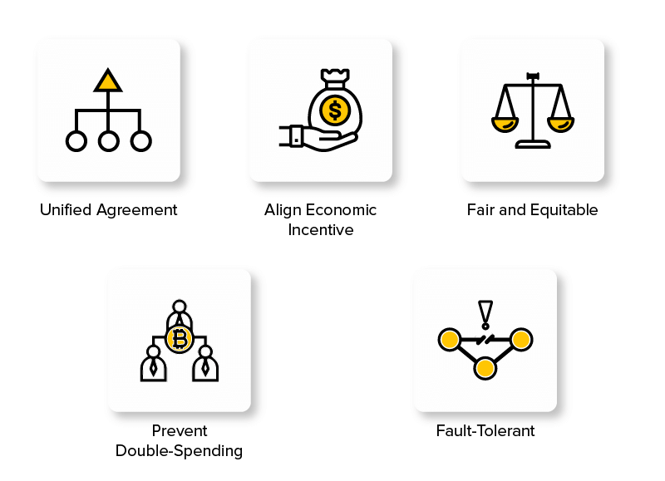
Consensus Algorithm
Procedure where all peers reach a common agreement about the current state of the distributed ledger, with the objective of:
Image Source- https://appinventiv.com/blog/blockchain-consensus-algorithms-guide/

Slide 9
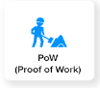
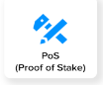

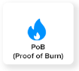
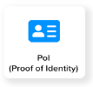
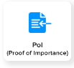
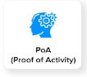
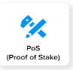
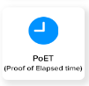
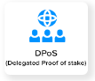
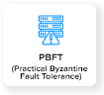
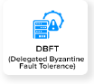
Types of Consensus Algorithms
Image Source- https://appinventiv.com/blog/blockchain-consensus-algorithms-guide/

Slide 10
Merkle Tree
Root
(H1H2H3H4)
Branch node
(H1H2)
Branch node
(H3H4)
Leaf node
(H 1)
Leaf node
(H 2)
Leaf node
(H 3)
Leaf node
(H 4)

Slide 11
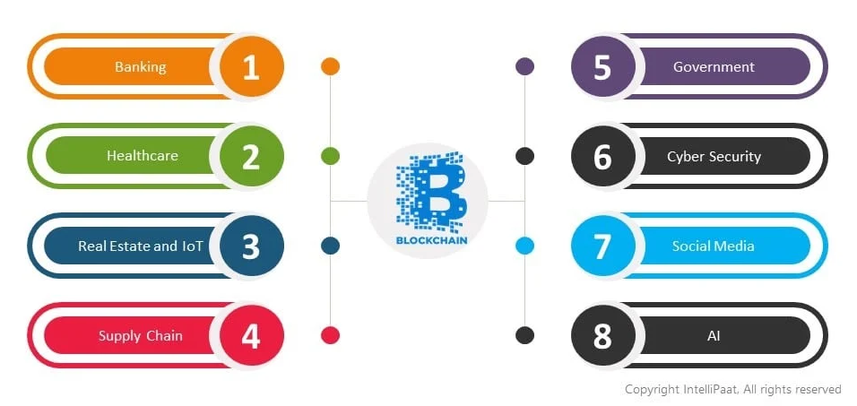
Applications

Slide 12


Slide 13
Intro to Post Quantum Cryptography
Join at
slidocom
#4525 959
Pavani Poluru

Slide 14
CONTENTS
CONTENTS
General Cryptography
Quantum computers
Basics of quantum computing
Effect of quantum computing on classical computing
Quantum Cryptography and Post Quantum Cryptography
Families of PQC
Qiskit Implementation

Slide 15


what is meant by cryptography?
ⓘ Start presenting to display the poll results on this slide.

Slide 16
General Cryptography
Cryptography security relies on hardness of math problem , proper implementation and key secrecy.

Slide 17


General Cryptography
Cryptography security relies on hardness of math problem , proper implementation and key secrecy.
Symmetric key encryption | Symmetric key encryption
You can give a brief description of the topic you want to talk about here. For example, if you want to talk about Mercury, you can say that it’s the smallest planet in the entire Solar System
Symmetric key encryption
ASymmetric key encryption/PKC
Example : AES,DES
Example : RSA, Diffie hellman, ECC

Slide 18
Quantum computing

Slide 19
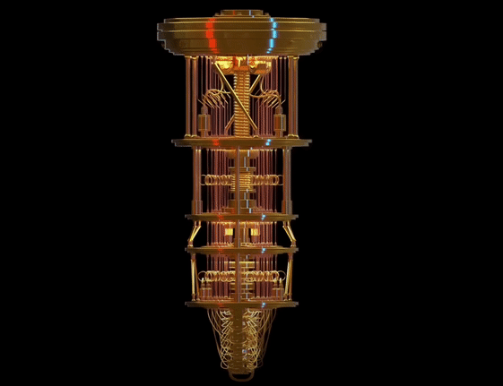
Quantum computing

Slide 20
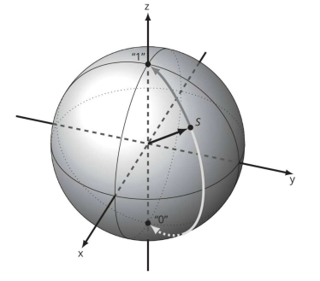
Quantum computing

Slide 21
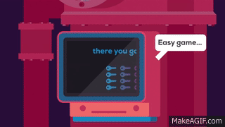
Quantum computing

Slide 22
Basics of Quantum Computing

Slide 23
Basics of quantum computing
Qubits :A basic unit of data in quantum computing . A qubit can be either in state |a⟩ or state|b⟩ or a superposition of both states. => ||a||²+||b||² = 1

Slide 24
Basics of quantum computing
Qubits :A basic unit of data in quantum computing . A qubit can be either in state |a⟩ or state|b⟩ or a superposition of both states. => ||a||²+||b||² = 1
Cbits : Special case of Qubits where a , b are either |0⟩ or |1⟩

Slide 25
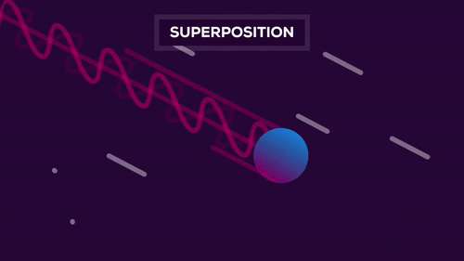
Basics of quantum computing
Qubits :A basic unit of data in quantum computing . A qubit can be either in state |a⟩ or state|b⟩ or a superposition of both states. => ||a||²+||b||² = 1
Cbits : Special case of Qubits where a , b are either |0⟩ or |1⟩
Superposition : The qubit is both 0 or 1 at the same time.

Slide 26
Basics of quantum computing
Qubits :A basic unit of data in quantum computing . A qubit can be either in state |a⟩ or state|b⟩ or a superposition of both states. => ||a||²+||b||² = 1
Cbits : Special case of Qubits where a , b are either |0⟩ or |1⟩
Superposition : The qubit is both 0 or 1 at the same time.
Entanglement : Two qubits are remains correlated even they are far apart.

Slide 27
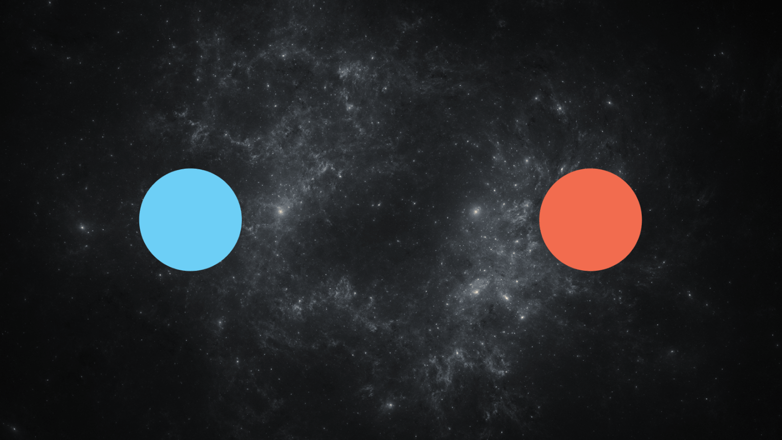
Basics of quantum computing
Qubits :A basic unit of data in quantum computing . A qubit can be either in state |a⟩ or state|b⟩ or a superposition of both states. => ||a||²+||b||² = 1
Cbits : Special case of Qubits where a , b are either |0⟩ or |1⟩
Superposition : The qubit is both 0 or 1 at the same time.
Entanglement : Two qubits are remains correlated even they are far apart.
Superposition
Entanglement
https://tenor.com/bmI32.gif

Slide 28
Basics of quantum computing
Representing classical bits as a vector
One bit with the value 0 , it is also written as |0⟩ (Dirac vector notation)
One bit with the value 1 , it is also written as |1⟩ (Dirac vector notation)
1
0
0
1

Slide 29
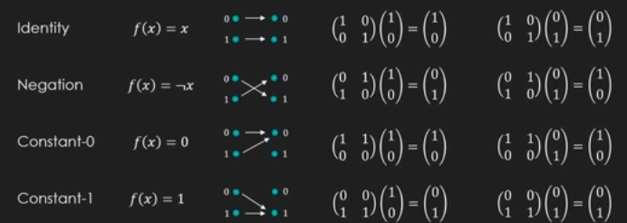
Cbit operations

Slide 30
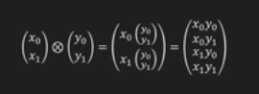
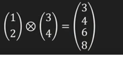
Tensor Product of vectors
Single cbit product

Slide 31
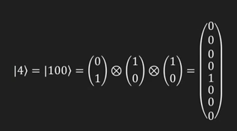
Tensor Product of vectors
Single cbit product
Multiple cbit product

Slide 32

Quantum gates
Quantum gates are building blocks of quantum computing
https://towardsdatascience.com/take-your-first-step-into-the-quantum-realm-a13e99fab886

Slide 33
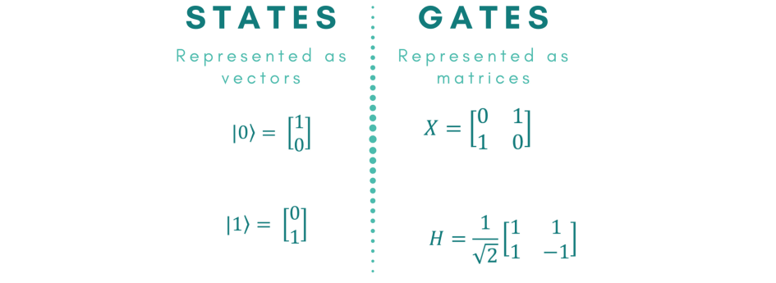
Quantum gates
Qubits(states) are multiplied with gates to apply a gate to a qubit in any state.
https://towardsdatascience.com/take-your-first-step-into-the-quantum-realm-a13e99fab886

Slide 34

Quantum gates
The Identity Gate
It leaves the state of the qubit unchanged.
This is reversible
https://towardsdatascience.com/take-your-first-step-into-the-quantum-realm-a13e99fab886

Slide 35

Quantum gates
The Identity Gate
It leaves the state of the qubit unchanged.
The Not Gate
It flips the state of the qubit.
https://towardsdatascience.com/take-your-first-step-into-the-quantum-realm-a13e99fab886

Slide 36
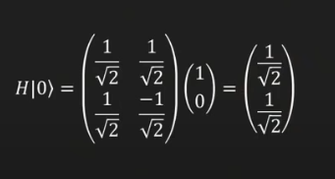

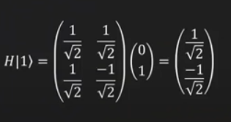
Quantum gates
The Hadamard Gate
This is responsible for creating superposition of states.
Plus State |+⟩
Minus state |-⟩
https://towardsdatascience.com/take-your-first-step-into-the-quantum-realm-a13e99fab886

Slide 37


Quantum gates
The Y gate
Similar to X gate and applies flip operation , Y gate flips the state |0⟩ and then multiplies the results by an imaginary number j (adds a phase to it).
The Z Gate
It does not flip the value of the state, it flips its phase
https://towardsdatascience.com/take-your-first-step-into-the-quantum-realm-a13e99fab886

Slide 38

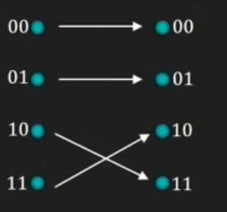
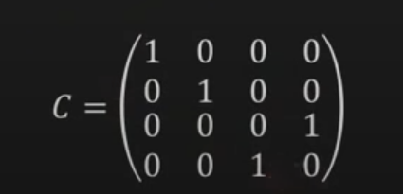
Quantum gates
CNOT gate
This operates on pair of bits.
If the control bit(MSB) is 1 , then target bit (LSB) is flipped.
If the control bit(MSB) is 0 , then target bit (LSB) is unchanged..
https://towardsdatascience.com/take-your-first-step-into-the-quantum-realm-a13e99fab886

Slide 39
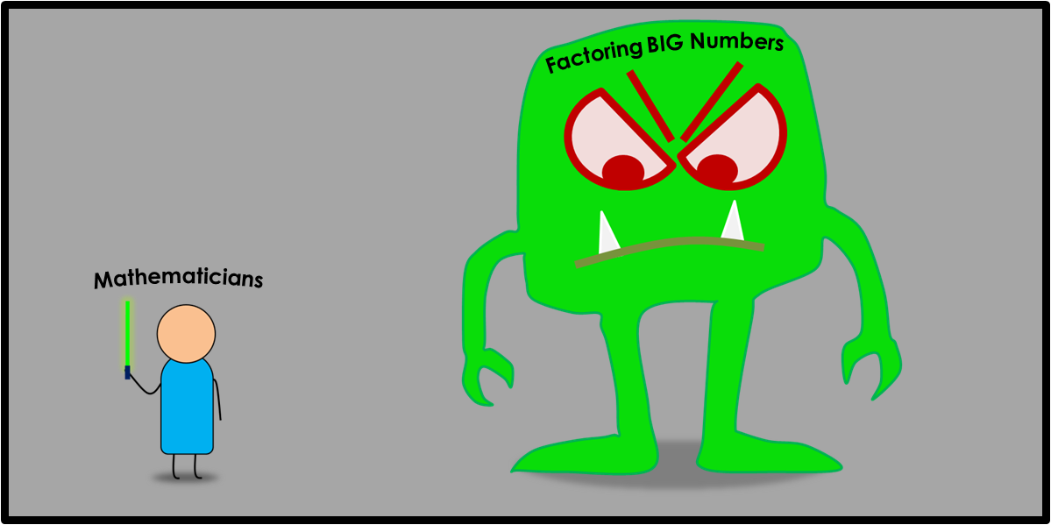
Effect on classical computing
Shor's algorithm:
Algorithm solves integer factorization and discrete logarithm problem.
Variants of shor’s algorithm can break all PKC algorithms.
https://kaustubhrakhade.medium.com/shors-factoring-algorithm-94a0796a13b1
Notes:
https://kaustubhrakhade.medium.com/shors-factoring-algorithm-94a0796a13b1

Slide 40

What is the time complexity of finding a number in this list?a = [1,3,2,4,5,7,8,9]
ⓘ Start presenting to display the poll results on this slide.

Slide 41
Effect on classical computing
Grover’s algorithm:
This is a quantum algorithm on unstructured search.
This gives a square root speedup on search problems.
To hold security , must double the size of the key of symmetric algorithms.

Slide 42
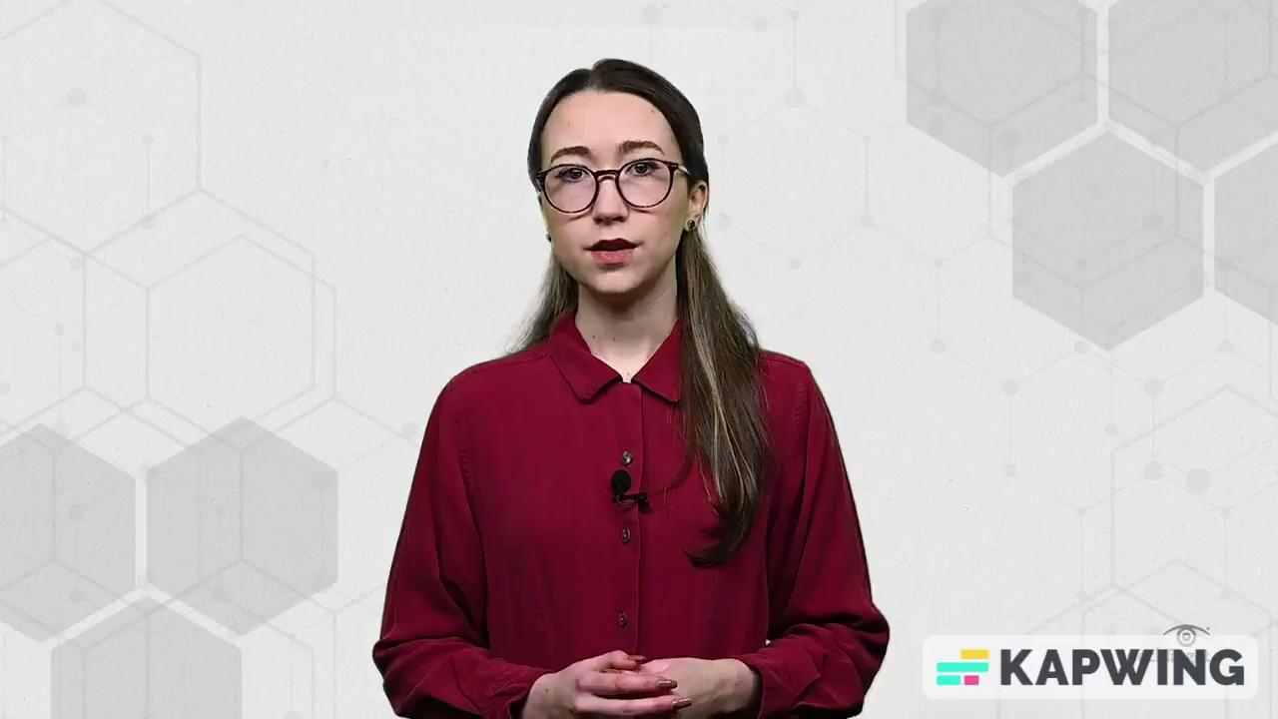
Quantum Cryptography
Quantum cryptography is based on the laws of quantum mechanics.

Slide 43
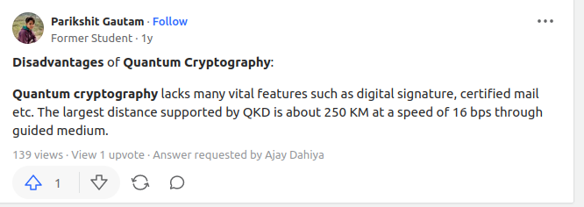
Post Quantum Cryptography
Problem : Quantum cryptography is expensive,large, and it can be applied with in the range.

Slide 44
Post Quantum Cryptography
Problem : Quantum cryptography is expensive,large, and it can be applied with in the range.
Solution: Post quantum cryptography can run on current computers and secure against classical and quantum attacks.

Slide 45
NIST on PQC
Post-Quantum Cryptography Standardization by NIST .

Slide 46
NIST on PQC
Post-Quantum Cryptography Standardization by NIST .
How to create new post quantum algorithm?
Identify hardness assumptions.

Slide 47
NIST on PQC
Post-Quantum Cryptography Standardization by NIST .
How to create new post quantum algorithm?
Identify hardness assumptions.
Build cryptosystems based on these problems

Slide 48
NIST on PQC
Post-Quantum Cryptography Standardization by NIST .
How to create new post quantum algorithm?
Identify hardness assumptions.
Build cryptosystems based on these problems
Prove security against quantum and classical attacks.

Slide 49
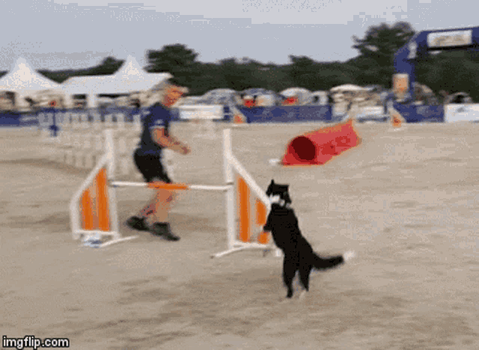
JOHN SMITH
ANNA BATES
TIM PATTERSON
You can speak a bit about this person here
You can speak a bit about this person here
You can speak a bit about this person here

Slide 50

JOHN SMITH
ANNA BATES
TIM PATTERSON
You can speak a bit about this person here
You can speak a bit about this person here
You can speak a bit about this person here

Slide 51
Families of post quantum schemes
Round 1 | Round 2 | Round 3
19 | 12 | 1
26 | 7 | 5
9 | 4 | 4
3 | 2 | 0
1 | 1 | 0
Code based
Lattice based
Multi variate
Hash variate
Elliptic curve isogeny

Slide 52
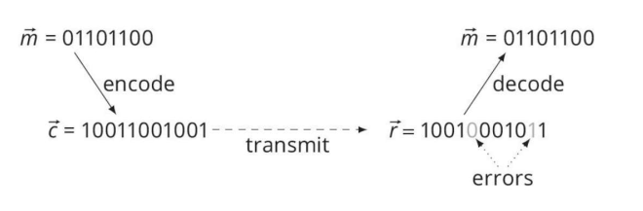
Code based cryptography
Use error-correcting codes in order to hide the message.
The hardness of decoding random linear code.
McEliece and Niederreiter cryptosystems
In real world, it’s used to share a random bit string.

Slide 53
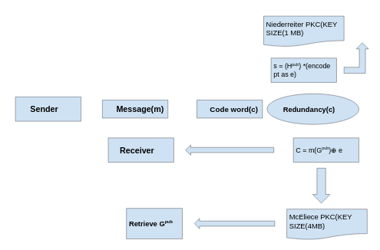
Code based cryptography

Slide 54
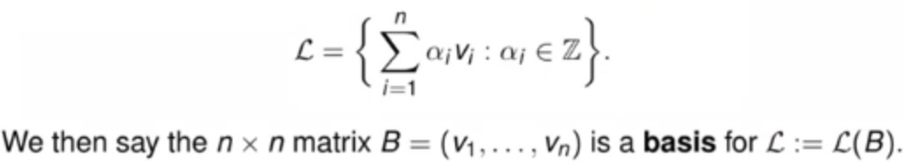
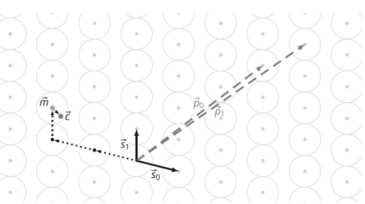
Lattice based encryption
Hard lattice problems
Given n linearly independent vectors v₁,...,v_{n} for n dimensional lattice is generated as

Slide 55
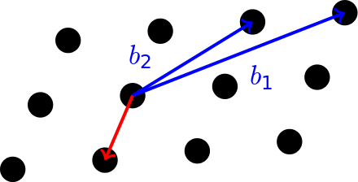
Hard lattice problems
Shortest vector problem : Find the shortest nonzero vector in the lattice.
Closest vector problem : Given a basis of a lattice and a vector not in the lattice, find the lattice vector with the least distance to the first vector

Slide 56
Hash based Cryptography
Hash functions are one-way functions.
Used mainly for signature algorithms.
Cryptosystem:
Private key of Alice : {rn₀,rn₁}
Calculate public key : {s_{o} = h(rn₀) ,s₁ = h(rn₁)}
Alice will have to send rn₀ , rn₁ to bob to verify.
Notes:
It maps bit strings of an arbitrary length to relatively short , fixed length bit string .

Slide 57
If I pass x1,x2 to one hash function, what would be the size of both hash values?
x1 = b' Hello newbie'
x2 = b' Ready to play here with you'
ⓘ Start presenting to display the poll results on this slide.
Notes:
📣 This is Slido interaction slide, please don't delete it. ✅ Click on 'Present with Slido' and the poll will launch automatically when you get to this slide.

Slide 58
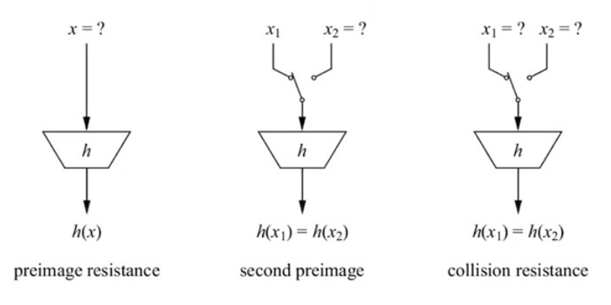
Hash based Cryptography
Hard problems assumed :
Notes:
It maps bit strings of an arbitrary length to relatively short , fixed length bit string .
Preimage resistance - Hard to compute hash value
Second preimage resistance - find a different bit string with same hash value.
Collision resistance - Hard to find two different bit strings with same hash value.

Slide 59
Multivariate Cryptography
This is based on multivariate quadratic problem
It is based on NP - hard and NP-complete problems.
NP-complete : The NP problems set of problems whose solutions are hard to find but easy to verify and are solved by Non-Deterministic Machine in polynomial time.
NP-hard: NP-Hard problems(say X) can be solved if and only if there is a NP-Complete problem(say Y) that can be reducible into X in polynomial time.
Notes:
The NP problems set of problems whose solutions are hard to find but easy to verify and are solved by Non-Deterministic Machine in polynomial time.

Slide 60
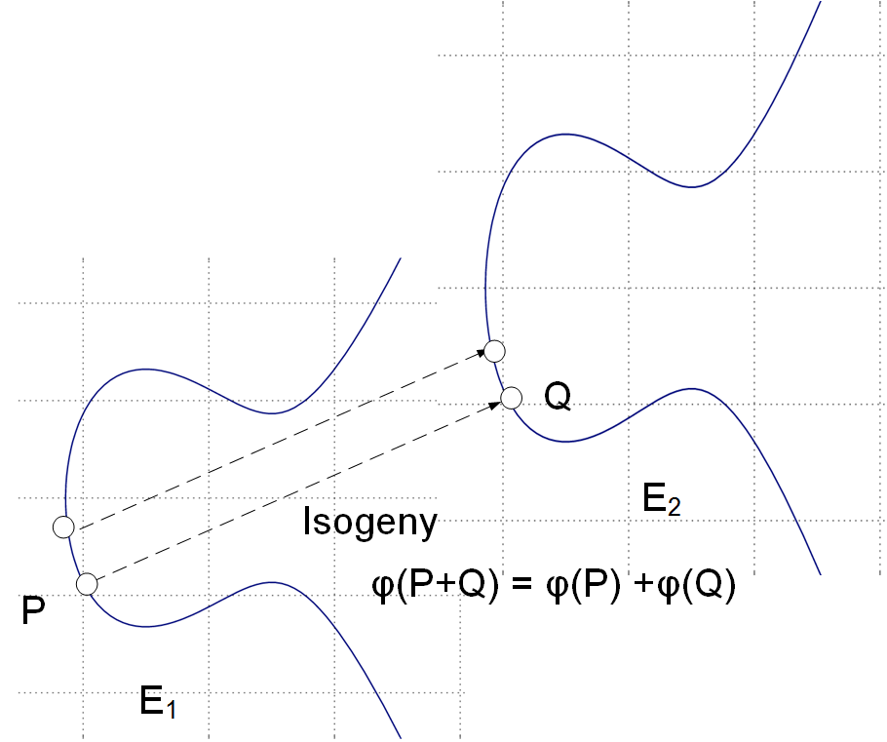
Isogeny based Cryptography
It maps between two elliptic curves
We say an isogeny between elliptic curves defined over a field k is a surjective morphism of curves which includes a group homomorphism E₁(kˉ)→E₁(kˉ).

Slide 61
Qiskit

Slide 62
Resources
Intro to cryptography
Shor’s algorithm
IBM circuit simulator
Quantum computing basics
Qiskit
Mercury is the closest planet to the Sun and the smallest of them all
Venus has a beautiful name and is the second planet from the Sun

Slide 63

Mercury is the closest planet to the Sun and the smallest of them all
Venus has a beautiful name and is the second planet from the Sun

